Slide 1
Match the word to the correct meaning
diversity | a degree qualification given by a university
equality | being devoted or committed to a task or project
doctorate | treating people the in an equal and fair way
dedicated | leading or being a leader of something
spearheaded | recognising difference and variety in people
End

Slide 2
Barbara Burford
LO: To understand how to retrieve information to create a timeline
By the end of the lesson you will have:
ALL pupils will highlight key events and information from a text (L3)
MOST pupils will place these in the correct order (L3/4)
SOME will create a timeline of Barbara Burford’s life (L4/5)

Slide 3
Read through the article and highlight/underline the key events or dates

Slide 4
Number these in the correct order:
Barbara went to Grammar School
Barbara received an honorary doctorate
Barbara joined the NHS
Barbara moved to North London
Barbara became director of equality and diversity

Slide 5
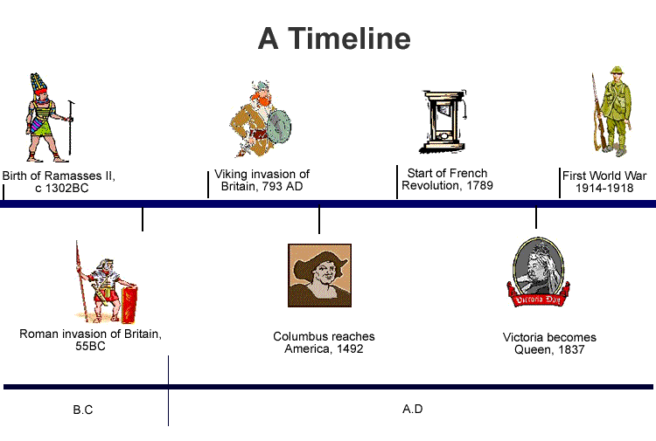
Create a timeline of Barbara Burford’s life
Success Criteria:
Correct spelling of names and dates
In the correct order
Use of images/symbols to show events
From birth to death
Includes at least 8 events

Slide 6
Put these events in the correct order
First Olympic Games
Battle of Waterloo
The internet invented
Moon Landing
Julius Caesar died
Shakespeare Born

Slide 7
ANSWERS
776 BC Olympic Games
44BC Julius Caesar died
1564 Shakespeare Born
1815 Battle of Waterloo
1969 Moon Landing
1970s Internet Invented

